Slide 1

M-PESA Instant Payment Notification
(IPN)

Slide 2
What is M-PESA IPN
MPESA IPN enables Paybill Partners to receive real-time notification to their systems whenever funds are sent to their Paybill Numbers. The notifications may be delivered in SMS, EMAIL or HTTP/S as shall be agreed between Safaricom and the Paybill Partners
The main objective M-PESA IPN application is to provide an efficient real-time way for Safaricom Paybill Partners to complete real-time transaction and therefore improve on the M-PESA C2B customer experience
Target Customers: All Paybill users. Especially those with a need to automate processes.

Slide 3
Benefits to Paybill Customer
Provides ability for customer to complete transactions instantly since your transactions can be verified.
Revenue increase due to increased transactions resulting from ease in use when paying for goods and services.
Cash flow management tool. M-PESA revenue is generally available for use by company within 48hrs unlike credit.
Enable e-commerce since business can integrate their Paybill Numbers with an online interface.

Slide 4
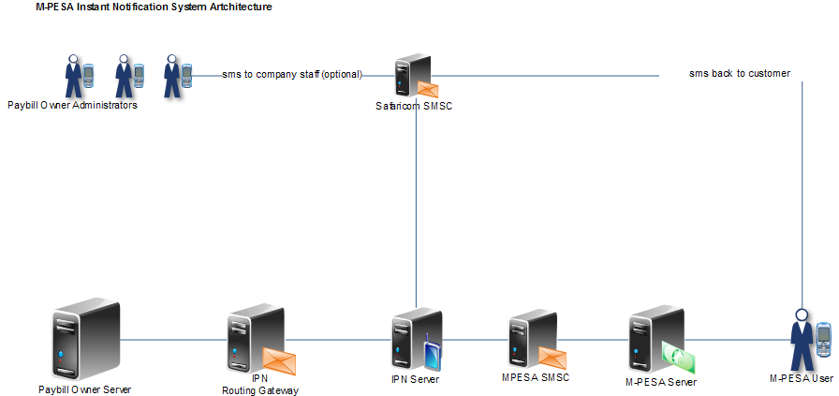
M-PESA IPN System Architecture

Slide 5
IPN Notification Standards/Protocols
HTTP/S
SOAP
ISO8583
SMS
EMAIL
SFTP

Slide 6
What is required?
M-PESA Paybill Number from Safaricom
Public IP or VPN/P2P Connection for Notifications

Slide 7
Connectivity
VPN recommended.
HTTPS public IP are less secure than VPN

Slide 8
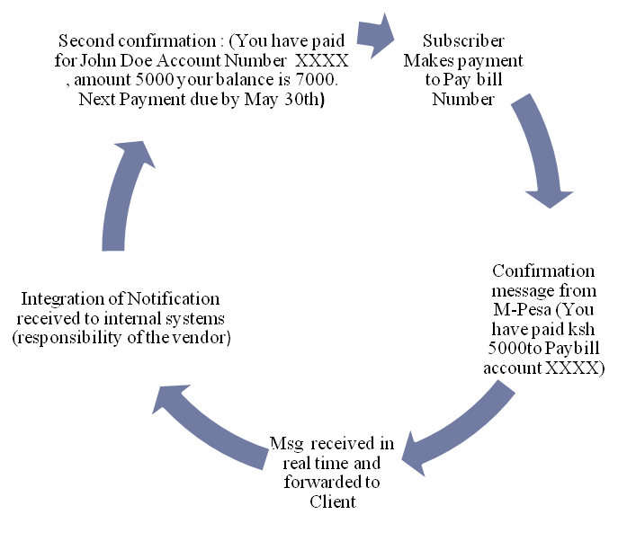
Subscriber Notification
All IPN connections will be required to have a response message to subscriber.
Mandatory information to be passed between the systems are as below:
Next anniversary date (when Payment is needed from subscriber)
Account Name
Account Balance (negative or positive)
Account Number
Real time acknowledgement of receipt of payment

